Slide 1
Machine Learning demystified: do you ask the right questions?
Bianca Furtuna
Technical Evangelist
@Fur_Bi

Slide 2


Slide 3
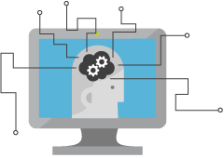
What is Machine Learning?
Computing Systems that become smarter with Experience
Experience = Past Data + Human Input
@Fur_Bi

Slide 4
Learning?
Y = aX - b
y = 4.8081x - 56.241
@Fur_Bi

Slide 5
How can Machine Learning bring value?
Machine
Learning
Data
Insights
@Fur_Bi

Slide 6
Questions?
Use maths to answer questions
@Fur_Bi

Slide 7
What type of questions?
Is this class A or class B?
Is this class A or class B or class C or …. class Z?
How much/How many?
Is this anomalous behaviour?
What are the patterns/groupings?
@Fur_Bi

Slide 8
Is this class A or class B?
Is there a face in this image or not?
Will this patient get lung cancer?
Will this machine fail in the next month?
= Two-class/Binary classification
@Fur_Bi

Slide 9
Is this class A or class B or class C or …. class Z?
What object is in this image?
What category best describes this article?
What is the sentiment of the customer comment?
= Multi-class classification
@Fur_Bi

Slide 10
How much/How many?
How much ice-cream will be sold?
How much is the price of this house?
How many hours of use are left for this piece of equipment?
= Regression
@Fur_Bi

Slide 11
Is this anomalous behaviour?
Is this sensor reading out of the normal range?
Is the internet usage unusual?
Is this online transaction unusual?
= Anomaly Detection
@Fur_Bi

Slide 12
What are the patterns/groupings?
Which of my customers have similar spending habits?
How can these news articles be grouped?
Which users have similar movie preferences?
= Clustering
@Fur_Bi

Slide 13
Machine Learning Myths
Machine Learning needs a lot of data
The more features the better
Machine Learning can get insights from any data
Machine Learning replaces human analysts
Machine Learning is all about the model you choose
@Fur_Bi

Slide 14
Machine Learning Process
Idea
Business Knowledge
Data Understanding
Data
Data Preparation
Modelling
Evaluation
Publish
Based on the CRISP-DM Model

Slide 15
Machine Learning Process
Use case
Data
Prep + Build + Test
Publish
Data Preparation
Evaluation
Modelling

Slide 16
Data
Clients
API
ML STUDIO
Model is now a web service that is callable
Blobs and Tables
Hadoop (HDInsight)
Relational DB (Azure SQL DB)
Integrated development environment for Machine Learning
Monetize the API through our marketplace

Slide 17
Demo
@Fur_Bi

Slide 18
Machine Learning Process
Use case
Data
Prep + Build + Test
Publish
Data Preparation
Evaluation
Modelling

Slide 19
Use Case/Scenario
AuthenticGiftsX is a company that is offering hand-made, personalised gifts which are dispatched in custom-made boxes. Their delivery labels are hand-written to give their customers a sense of authenticity. In order to improve and automate their delivery system they want a mobile app which can recognize the delivery address based on a picture of the label.
@Fur_Bi

Slide 20
Machine Learning Process
Use case
Data
Prep + Build + Test
Publish
Data Preparation
Evaluation
Modelling

Slide 21
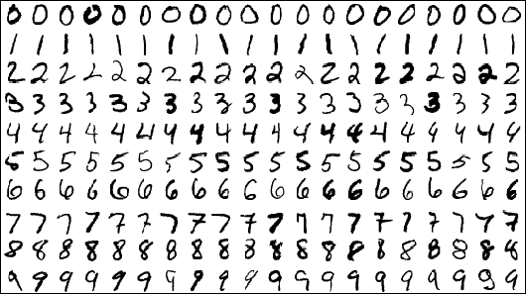
Data
MNIST dataset which consists of 70,000 grayscale images of hand-written digits
28x28 pixels
@Fur_Bi

Slide 22
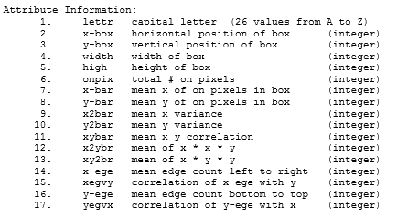
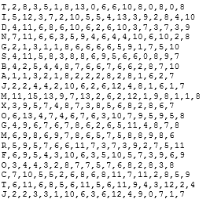
Data
Letter recognition data from UCI Machine Learning repository
20000 unique images
@Fur_Bi

Slide 23
Machine Learning Process
Use case
Data
Prep + Build + Test
Publish
Data Preparation
Evaluation
Modelling

Slide 24
What is a neural network?
@Fur_Bi

Slide 25
Machine Learning Process
Use case
Data
Prep + Build + Test
Publish
Data Preparation
Evaluation
Modelling

Slide 26
Action !!!
Go to Azure Machine Learning Studio and create your first experiment.
@Fur_Bi

Slide 27

Thank you!
Twitter @Fur_Bi
bifurt@microsoft.com
Demos https://github.com/MSFTImagine/computerscience/tree/master/Workshop/4.%20Machine%20Learning
http://://furbi.azurewebsites.net/

